Slide 1
Security and Privacy
Fall 2019
Instructor: Dr. Saeed Samet
School of Computer Science
University of Windsor

Slide 2
Chapter 1
Introduction

Slide 3

Why Security and Privacy?
Beep ….
It is reported that dead bodies are rising from their graves and attacking the living.
They are extremely dangerous. Do not attempt to approach them.
Beep …

Slide 4
Why Security and Privacy?
Data communication between two or more parties
Government
Business
Military
Individuals
Social Networks
Storing sensitive information
Personally Identifiable Information (PII)
Health information
Financial information

Slide 5
Why Security and Privacy? (cont.)
System security
Operating Systems
File systems
Networks
Secure Computation
Privacy-preserving data mining
Privacy-preserving statistical analysis
System protection
Embedded software
Fraud detection
Intrusion detection

Slide 6
Questions to Answer
What kinds of vulnerabilities computing systems are prone to?
Why these vulnerabilities are exploited?
What are the different kinds of attacks?
Who is involved and contributed to the security problem?
How to prevent possible attacks?

Slide 7
Computer Intrusion Characteristics
Any system is most vulnerable at its weakest point
Principle of Easiest Penetration:
An intruder
Must be expected to use any available means of penetration
The penetration
may not necessarily be by the most obvious means
is not necessarily the one against which the most solid defense has been installed
does not have to be the way we want the attacker to behave.
All possible means of penetration must be considered
Repeatedly
Whenever the system and its security change

Slide 8
Computer Security is the protection of . . .

Slide 9
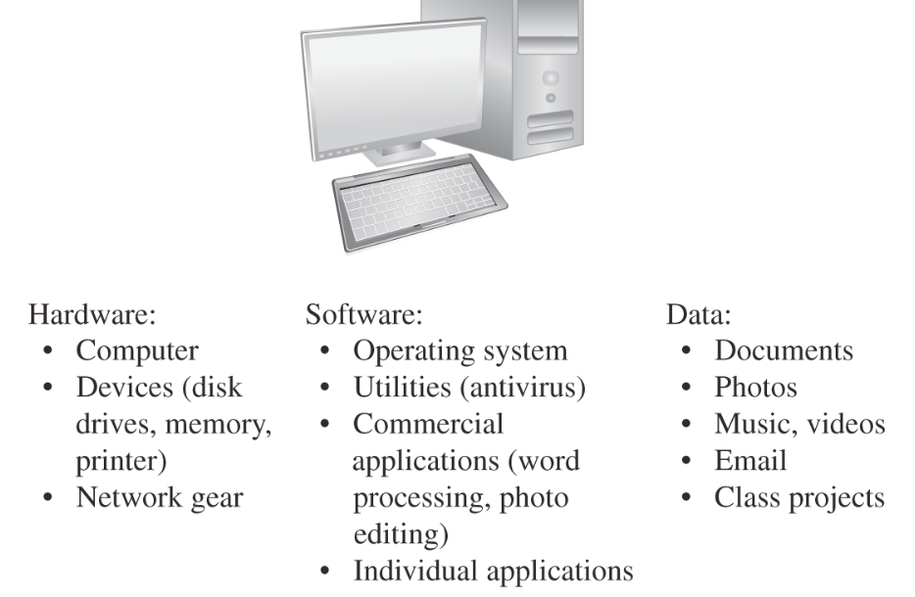
Computer Objects of Value
Notes:
Computer security is the protection of the items we value, called assets.
Data are usually irreplaceable and hard or impossible to recreate.
Custom made software and hardware are more valuable than commercial ones.
Value of assets depends on the asset owner’s or user’s perspective:
Monetary cost
Replacement cost
Timing

Slide 10
A Framework for Computer Security
How assets may be harmed,
and
How to counter or at least mitigate that harm.

Slide 11
Analyze a System from a Security Perspective
Vulnerabilities
Weakness in the security system
Vulnerable to unauthorized data manipulation
Threats
A set of circumstances that has the potential to cause loss or harm
Illicit copying of program or data files
Attacks
Harm or loss committed by a person or system who exploit a vulnerability
DOS attack
Notes:
The goal of Computer Security is to protect valuable assets.
We should use a framework to describe how assets can be harmed, and how to counter or mitigate that harm.

Slide 12
Analyze a System from a Security Perspective (cont.)
Controls
The ways to address committed, or possible attacks
The ways to protect systems
Could be actions, devices, procedures, or techniques that remove or reduce vulnerabilities
A Threat is blocked by Control of a Vulnerability

Slide 13
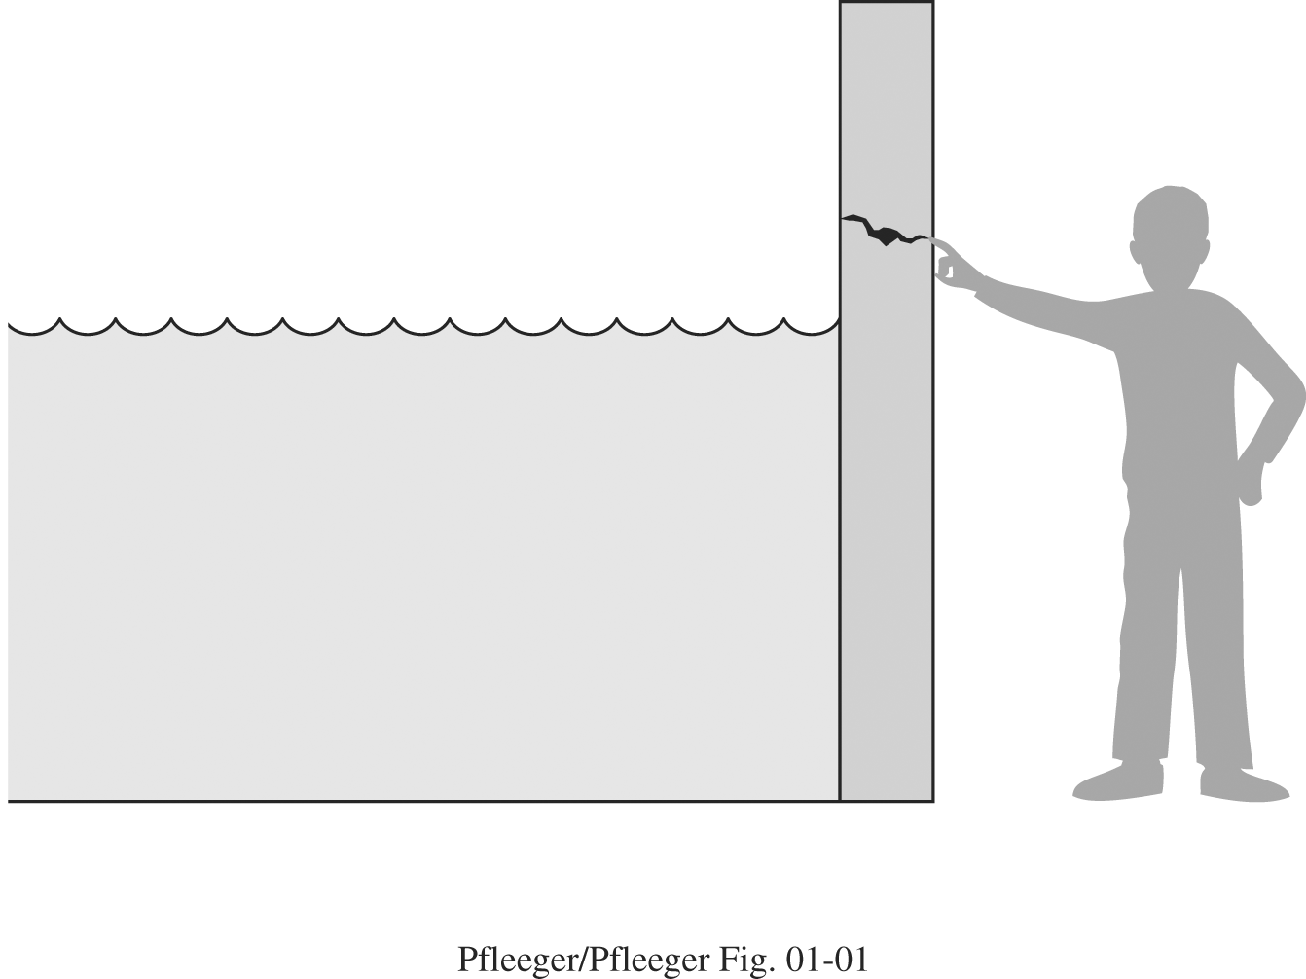
Analyze a System from a Security Perspective (cont.)
Control
Vulnerability
Threat

Slide 14
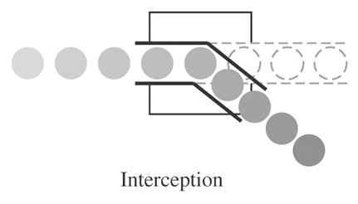
Threats
Interception
Unauthorized access to an asset by a party (person, program, system)
Wiretapping networks to obtain data
Illicit copying of data files or systems
Notes:
Before we can protect assets, we need to know the kinds of harm we have to protect them against, i.e. threats.

Slide 15
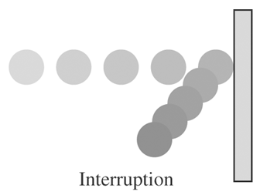
Threats
Interruption
An asset of the system becomes lost, unavailable, or unusable
Delete a file
Hardware device destruction
Failing OS functions

Slide 16
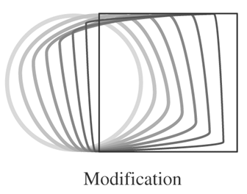
Threats
Modification
Unauthorized changes to data or systems
Change values in database
Altering a program or system
Hardware modification

Slide 17
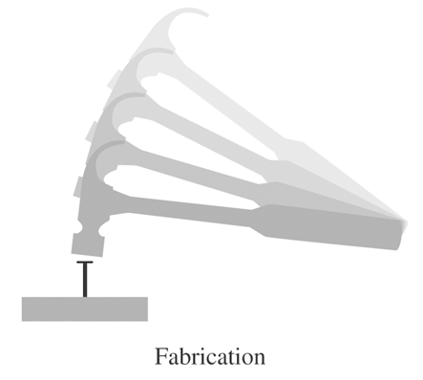
Threats
Fabrication
Insert counterfeit objects to the system
Insert spurious transactions to a network communication system
Add records to an existing database

Slide 18
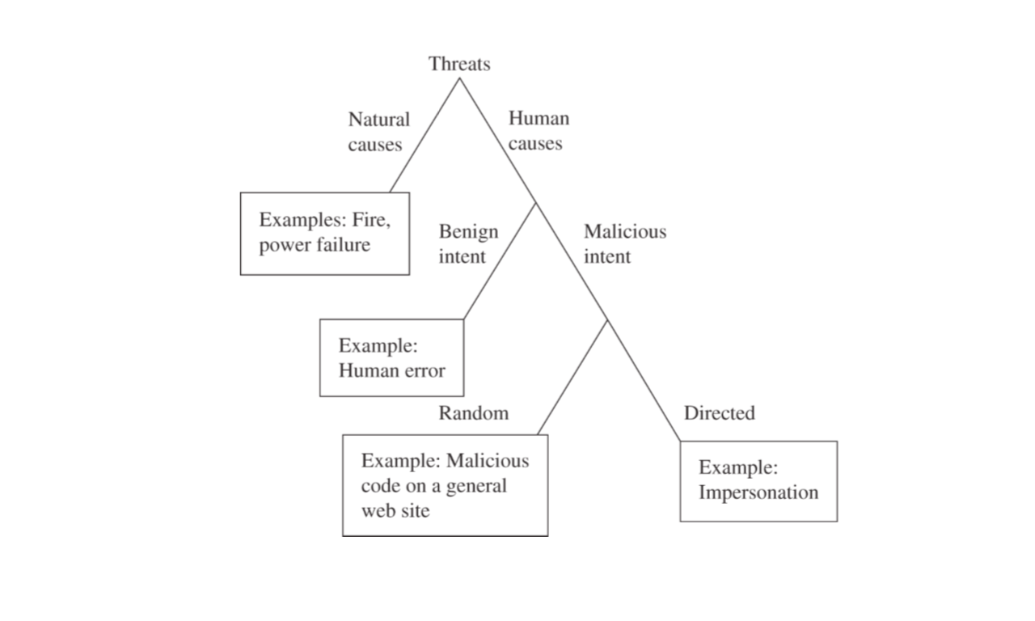
Kinds of Threats

Slide 19
What do I Need to Attack to a System?

Slide 20
Attack Method, Opportunity, and Motive
A malicious attacker must have:
Method: Skills, knowledge, and tools
Opportunity: Time and access
Motive: Reason to want to perform an attack
Show attacker’s power, ability and skills
Financial
Political (civil disobedience, espionage, …)
Random
Easy to access
…
Notes:
To prevent an attack, we should deny the attackers the feasibility of the threat action.

Slide 21
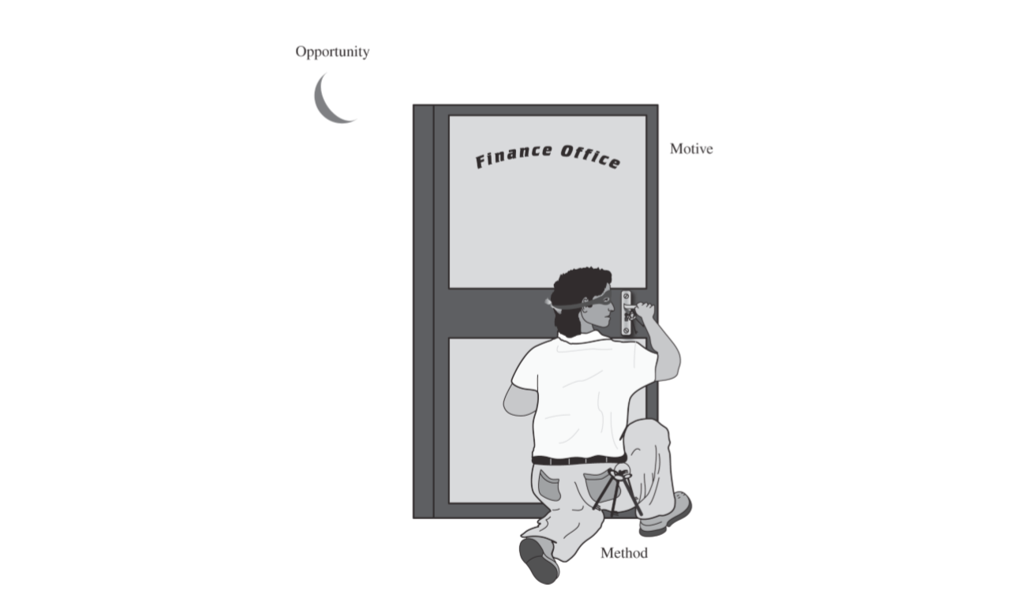
Method-Opportunity-Motive

Slide 22
Security Triad (Three Goals of Security)

Slide 23
Computer Security
Addressing three important aspects of any computer-related system
Confidentiality
Assets are accessed only by authorized parties
Access means reading, printing, or simply knowing that a particular asset exists
Integrity
Assets can be modified only by authorized parties or only in authorized ways
Modification includes writing, changing, changing status, deleting, and creating
Availability
Assets are accessible to authorized parties at appropriate times
Notes:
Computer Security Properties or Goals. Give an example, for instance about a stolen computer
There are three other properties, for communication networks, that sometimes will be added to these three:
Authentication: The ability of a system to confirm the identity of a sender
Nonrepudiation or Accountability: the ability of a system to confirm that a sender cannot convincingly deny having sent something
Auditability: the ability of a system to trace all actions related to a given asset

Slide 24
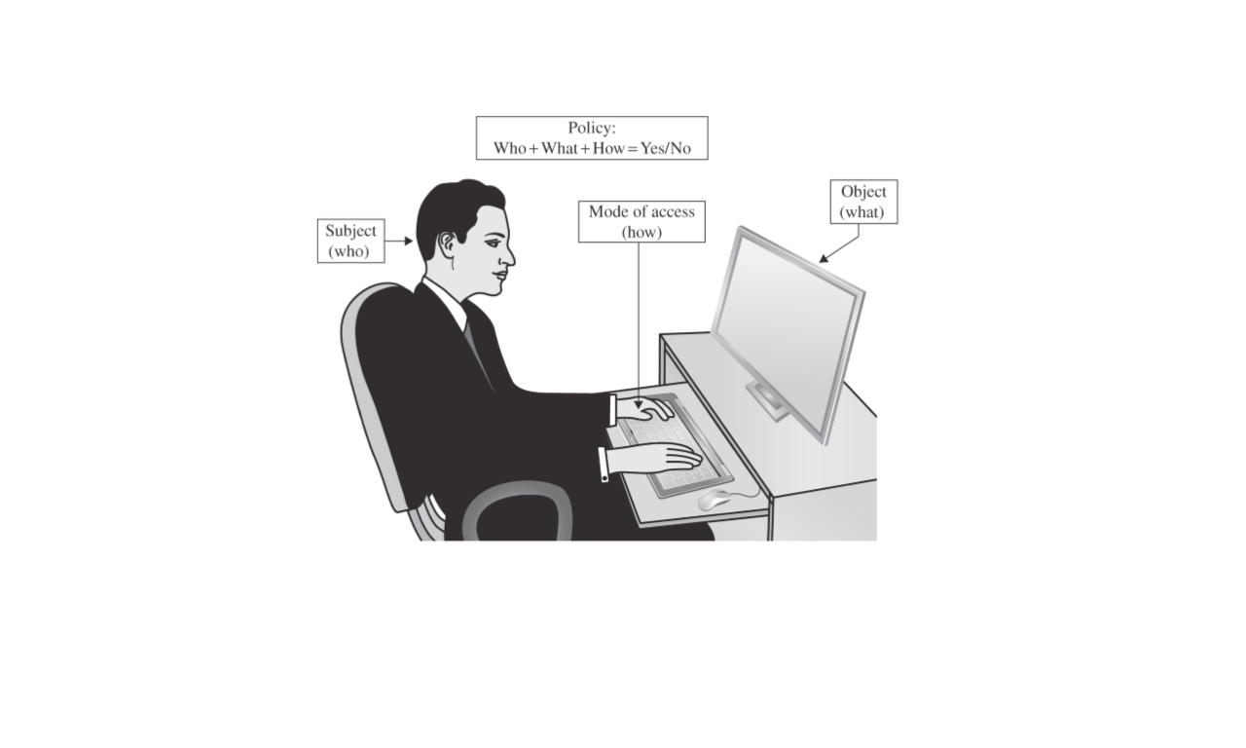
Access Control
Notes:
Usually we are dealing with 4 things for confidentiality and integrity:
Subject (person, process, or program), Who
Object (data item) What
Access mode (read, write, modify, execute,…), How
Policy (final result of authorization)

Slide 25
Any Other Security Goal?

Slide 26
Computer Security (cont.)
Challenge:
A right balance among the goals
Example
Preserve confidentiality by preventing everyone from reading an object
This system is not secure, because of not considering availability
Aspects could be
Independent
Overlapped
Mutually exclusive
Notes:
A small, centralized control of access is fundamental to preserve confidentiality and integrity, but might not availability. Single point of control, can be single point of failure, easy to be attacked to make the system unavailable.

Slide 27
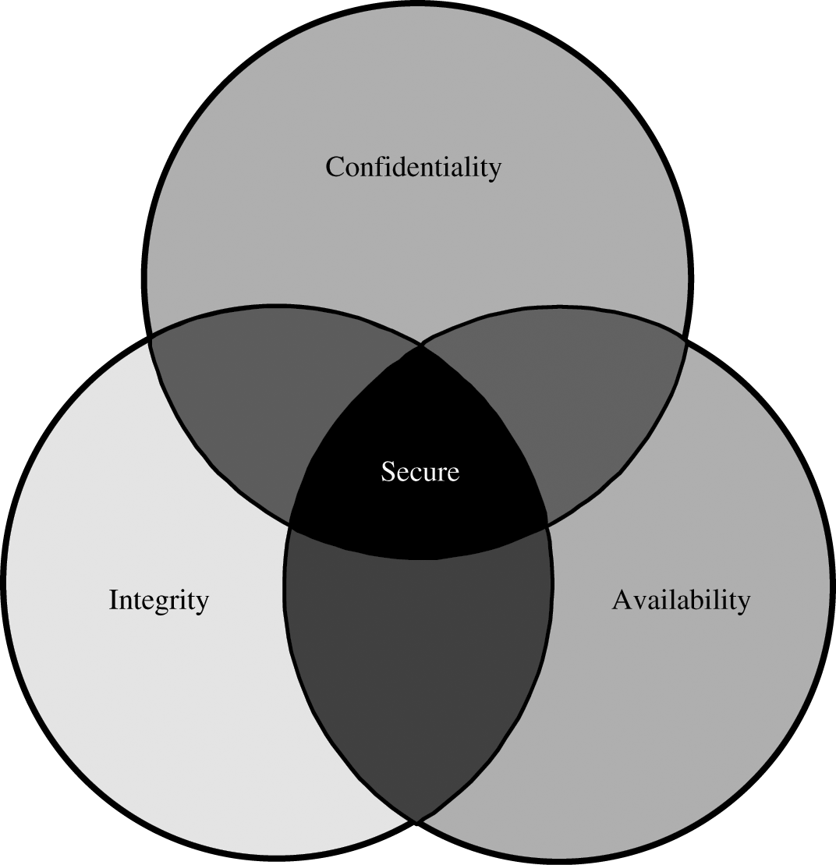
Computer Security (cont.)
Relationship between Confidentiality, Integrity, and Availability

Slide 28
Computer Security (cont.)
Aspects’ issues
Confidentiality
Who determines the access authorization for users?
What is the limit of any access?
What are the user’s obligation?
Integrity
What is the exact meaning of integrity?
Precise, accurate, unmodified, consistent, …
Authorized actions
Separation and protection of resources
Error detection and correction

Slide 29
Computer Security (cont.)
Aspects’ issues
Availability
To both data and services (processing)
Timely response to requests
Fair resource allocation
Fault tolerance
Easy use of services
Concurrency issues
Simultaneous access
Deadlock management
Exclusive access

Slide 30
What types of Vulnerabilities We Have?

Slide 31
Vulnerabilities (Attack Surface)
Hardware vulnerabilities
Adding, changing or removing devices
Data traffic interception
Physical attacks, with water, fire, power surges, …
Theft (PC, laptop, …)
DOS attack
Software vulnerabilities
Software deletion
Software modification
Software theft

Slide 32
Vulnerabilities (cont.)
Data vulnerabilities
Even difficult to measure, data have a value
Second principle of computer security
Data must be protected only until they lose their value, to a degree consistent with their value
Data Confidentiality
Prevents unauthorized disclosure of a data item
Wiretapping
Inferring one data point from other values
Data Integrity
Prevents unauthorized modification
Salami attack
Data Availability
Prevents denial of authorized access

Slide 33
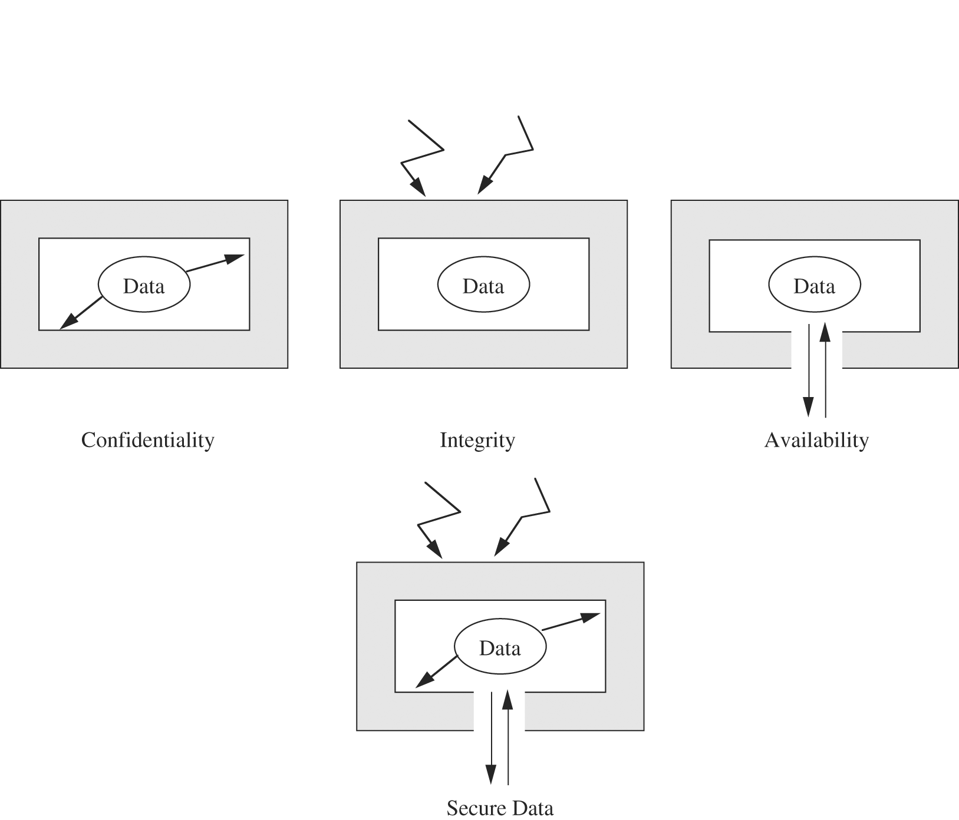
Vulnerabilities (cont.)
Data Security

Slide 34
A short Kahoot Quiz
https://kahoot.it

Slide 35
Any Other Types of Assets in a Computer System?

Slide 36
Vulnerabilities (cont.)
Networks
A collection of hardware, software and data
Security issues are multiplied
Lack of physical proximity
Use of insecure shared media
Inability to identify remote users
Access
Stealing computer time to do general-purpose computing
Malicious access to computing system to destroy software or data
Unauthorized access may deny service to legitimate user
Key People
People can be weak points in security
Trouble can arise if only one person knows how to use or maintain a particular program or system

Slide 37
Computer Criminals
Who can breach the system’s confidentiality, integrity and availability
One approach to prevention or moderation of computer crimes is to understand computer criminals and their motivations

Slide 38
Computer Criminals
Amateurs
Most of the computer crimes are committed by them
Crackers or Malicious Hackers
Enjoy the simple challenge of trying to log in to the systems
Attack for curiosity, personal gain, self-satisfaction, causing chaos, loss or harm

Slide 39
Computer Criminals
Career Criminals
Understand the targets of computer crime
Come from organized crime and professional criminals
Mostly because of financial profit
Companies usually remain silent instead of prosecuting computer criminals
Terrorists
They use computers in three ways
Targets of attack (DOS attack)
Propaganda vehicles (fast and inexpensive ways to send messages)
Methods of attack (launch offensive attacks requires use of computer)

Slide 40
Methods of Defense
We can deal with harm in several ways
Prevent it
Blocking the attack or closing the vulnerability
Deter it
Making the attack harder but not impossible
Deflect it
Making another target more attractive
Mitigate it
Making the attack’s impact less severe
Detect it
Either as it happens or some time after the fact
Recover it
From it effects
More than one of the above ways can be done at once

Slide 41
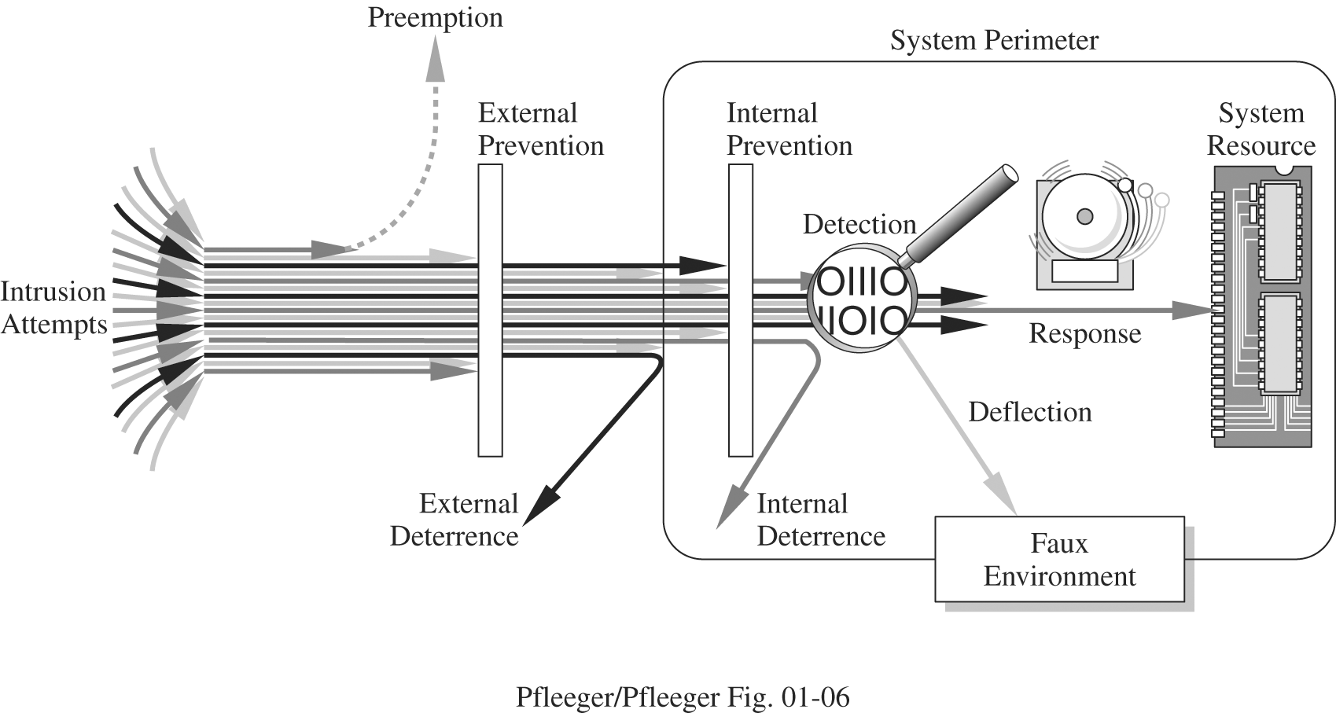
Controls
What we are protecting
How the cost of protection compares with the risk of loss
How hard would be the intruders’ attempts

Slide 42
Controls (cont.)
Physical: Using something tangible
Walls
Fences
Locks
(Human) guards
Sprinklers and fire extinguishers

Slide 43
Controls (cont.)
Procedural or Administrative: Using a command or agreement
Requires or advises people how to act
Laws, regulations
Politics, procedures, guidelines
Copyrights, patents
Contracts, agreements

Slide 44
Controls (cont.)
Technical: Using technology (software or hardware)
Passwords
Program or operating system access controls
Network protocols
Firewalls, intrusion detection systems
Encryption
Network traffic flow regulators

Slide 45
Controls (cont.)
Data Encryption
Process of data scrambling
Cleartext (plaintext)
Ciphertext (enciphered text)
Encryption key
Can address confidentiality, integrity and availability
Issues
Performance degradation
Weak encryption
Data Anonymization
Sampling
Anonymizing
Randomizing
Suppressing

Slide 46
Controls (cont.)
Software Controls
Internal program controls
Access limitation in a database management program
Operating system and network system controls
Limitations enforced by OS or network to protect users from each other
Independent control programs
Application programs, such as password checkers, intrusion detection utilities, or virus scanners
Development controls
Quality standards to design, code, test and maintain software programs

Slide 47
Controls (cont.)
Hardware Controls
Hardware or smart card implementations of encryption
Locks or cables for limiting access and deterring theft
User’s identity verification devices
Firewalls
Intrusion detection systems
Circuit boards that control access to storage media

Slide 48
Controls (cont.)
Effectiveness of Controls
Awareness of Problem
People will willingly cooperate with security requirements if they understand why security is appropriate in a situation
Likelihood to Use
No control is effective unless it is used
Principle of Effectiveness:
Controls must be used-and used properly- to be effective. They must be efficient, easy to use, and appropriate.

Slide 49
Controls (cont.)
Effectiveness of Controls (cont.)
Overlapping Controls (Layered Defense)
Physical access control
File locking
Periodic Review
Few controls are permanently effective without reconsidering and improvements
It is an ongoing task
Overlapping controls (but two controls are not always better than one, and could be even worse in some cases)
Principle of Weakest Link:
Security can be no stronger than its weakest link.
Two controls are not always better than one, and could be even worse.

